Slide 1

Expert market usa
Fatima Tanveer, Binita Thummar, Elena Ponomareva, Bari Vadaria

Slide 2

Stakeholders
Stakeholders are those who are invested in the project, care about it, and generally have something to gain or lose depending on the success of the project. In this case, the project would be the website. The stakeholders are top management, the project team, and customers.

Slide 3
Stakeholders ExpertMarketUsa.net
Developers
Product Owner (Tushar Patel)
Business Analyst (Rina Patel)
QA (Binita Thummar)
QA (Bari Vadaria)
QA (Fatima Tanveer)
QA (Elena Ponomareva)

Slide 4
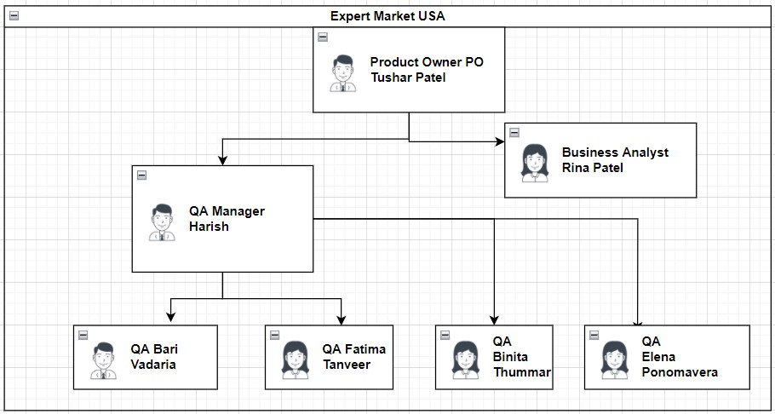
Team Structure
For small businesses, such as this one, they must create a culture of quality that gives everyone responsibility for managing their processes, identifying improvement initiatives, and roles are assigned by department heads. Everyone should be communicating with each other. The quality manager’s role needs to be focused on understanding what’s working in the business and how this can be repeated to grow, asking questions like are they the best at customer service? Are they strongest at utilizing new ideologies/technologies?

Slide 5
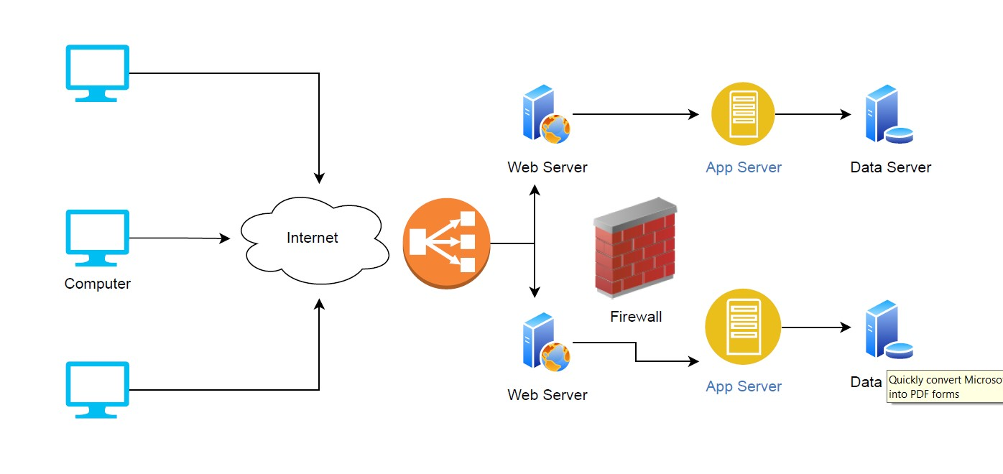
Architectural Diagram
The presentation tier is the user interface layer of the application, where the end user interacts with the application. The next tier is where the information collected in the presentation tier is processed. Then, the database tier is where information processed by the application is stored and managed.

Slide 6

Roles | Resoponsibilities
Bari Vadaria (QA) | Defined Stakeholders Defined Team Structure & Created Architectural Diagram
Binita Thummar (QA) | Defined Test Scope Defined Testing Approach Constructed Testing Schedule
Elena Ponomareva (QA) | Created Test Data Performed Unit/Functional tests RAID
Fatima Tanveer (QA) | Coordinated test plan & communication plan Prepared Test Cases & Test Steps Reviewed test summary

Slide 7
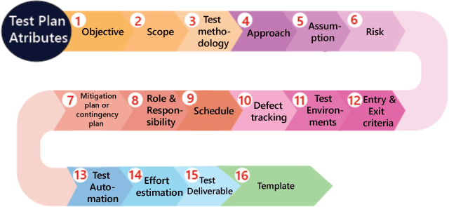

Slide 8
Test Scope
Type of testing
Functional testing- Manual
In scope testing

Slide 9
The scope of this Testing project is the modules of “Expert Market USA” as defined below
In-Scope :
The below modules are considered in-scope of testing for this project:
Shopping cart functionality
Searching for an item
Out of Scope:
All Non-Functional Testing are out of scope for this testing project.
PerformanceTesting
UserExperience Testing
Black Box Testing/Functional Testing

Slide 10
Test Approaches Functional testing Shopping cart
The primary goal of an Expert market USA site is to sell goods online. This project deals with developing a website for online products sale. It provides the user with a catalog of different product available for purchase. In order to facilitate online purchase a shopping cart is provided to the user.
Implicit knowledge are used to judge whether or not something is working as expected.
To ensure that the product actually meets the users need and that specifications were correct in the first place.
Testing of function ( Functional testing):Testing based on an analysis of the specification of the functionality of a component or system.

Slide 11
Test Scenarios
Test Scenario ID | TS001
Test Scenario Name | Adding Items to Cart
Test Scenario Description | A user should be able to add an item to the shopping cart
Actor | Customer
Pre-Condition | User has internet User has ExpertMarketUSA URL
Post Condition | For Success – Item gets added to shopping cart
Test Scenario ID | TS002
Test Scenario Name | Product Search
Test Scenario Description | A user should be able to search an item and the corresponding items should be displayed
Actor | Customer
Pre-Condition | User has internet User has ExpertMarketUSA URL
Post Condition | For Success – Product detail page shows up

Slide 12
Test Case for Adding Items to Cart
Test Case ID | TC_AddItems01
Test Case Name | Add items to cart
Test Case Description | A user should be able to add an item (Jewelry, Home Décor, Apparel, Customized Office Supplies) to the shopping cart
Test Case Prerequisites | User is authorized Shopping items are available

Slide 13
Test Step ID | Test Steps | Test Data | Expected Result | Actual Result | Test Status | Test Comments
1. | Launch Webpage | www.ExpertMarketUSA.net | System shows ExpertMarketUSA home page | Displays the ExpertMarketUSA homepage | Pass | [Fatima 5/06/22 6:30 PM]: Launch Successful
2. | User clicks on the word “Apparel” in the horizontal menu bar and selects “Women” from the drop-down menu | None | System shows all of “women” products | Displays the drop-down menu and then displays all “women” products, starting with handbags | Pass | [Fatima 5/06/22 6:31 PM]: Drop-down Menu functional & Display Successful
3. | Select a handbag and click “Add to Cart” | Women’s Handbag | Item should pop up in a new window, with colors available and quantities required for adding. | Item is displayed with its color choices and quantity selection. | Pass | [Fatima 5/06/22 6:33 PM]: Button functional and Pop-up Successful
4. | Choose the color and quantity of a handbag, and then “Add to Cart.” | Color: Black, Quantity: 5 | System should allow the user to add the item after choosing the color “Black” and in “5” quantity. System should display the side pop up panel with a shopping cart with the added item and its correct quantity in it. | five black women’s handbags are added to the cart, and it’s displayed in the pop-up side panel of cart. | Pass | [Fatima 5/06/22 6:34 PM]: Addition of an item with it’s quantity successful

Slide 14
5. | Repeat steps 1-3 or just step 3 | Traditional Handbag | System should add the item directly to the cart | Item is displayed directly in the cart | Pass | [Fatima 5/06/22 6:37 PM]: Item display successful in cart.
6. | Choose the quantity of handbag in the cart | Quantity: 3 | System should allow the user to increase the quantity of the item added | The quantity of the item is adjusted and displayed. | Pass | [Fatima 5/06/22 6:38 PM]: Quantity update successful.
7. | Click on “View Cart” to view the items added | None | System should show all the items added with their correct quantities and total amount | Total items added are displayed with their correct quantities and total amount | Pass | [Fatima 5/06/22 6:39 PM]: Adding all items to cart successful.

Slide 15
Test Case for Product Search
Test Case ID | TC_ItemSearch01
Test Case Name | Search Products
Test Case Description | A user should be able to search any item (Jewelry, Home Décor, Apparel, Customized Office Supplies)
Test Case Prerequisites | Shopping items are available

Slide 16
Test Step ID | Test Steps | Test Data | Expected Result | Actual Result | Test Status | Test Comments
1. | Launch Webpage | www.ExpertMarketUSA.net | System shows ExpertMarketUSA home page | Displays the ExpertMarketUSA homepage | Pass | [Fatima 5/06/22 6:27 PM]: Launch Successful
2. | User types the search word “rings” and clicks on search icon or presses enter. | Rings | System should display all the rings and it’s details available on the ExpertMarketUSA website | Displays all the rings and its details | Pass | [Fatima 5/06/22 6:28 PM]: Search Successful
3. | User types the search word “shoes” and clicks on search icon or presses enter. | Shoes | System should display all the shoes and it’s details available on the ExpertMarketUSA website | Displays all the shoes and its details | Pass | [Fatima 5/06/22 6:29 PM]: Search Successful

Slide 17

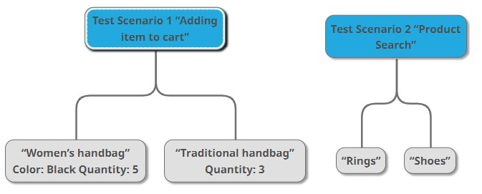
Test Data

Slide 18
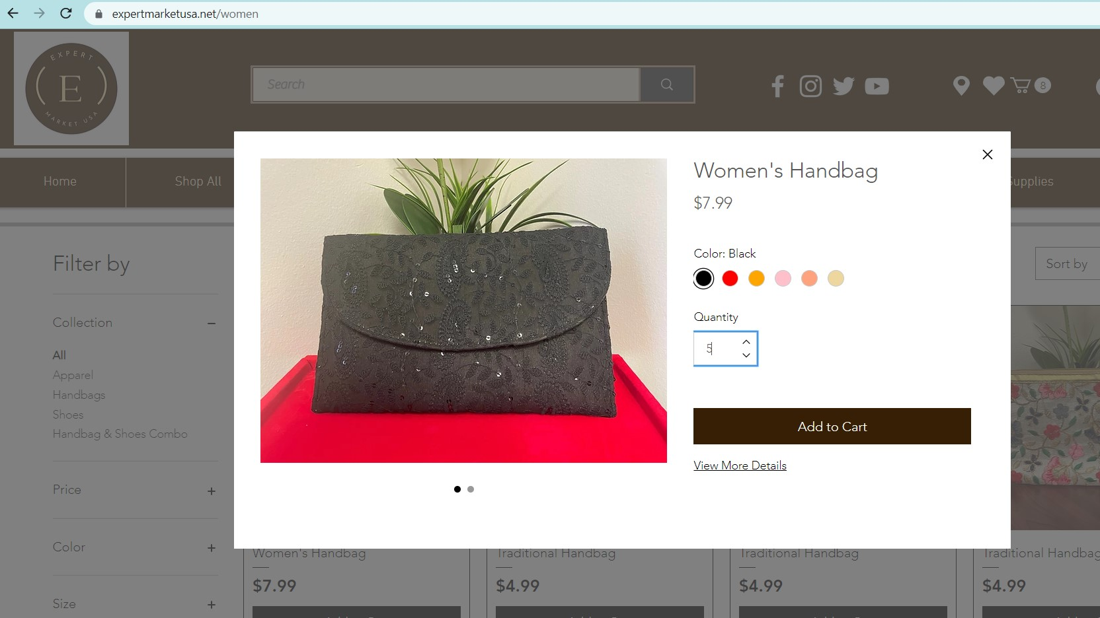

Slide 19
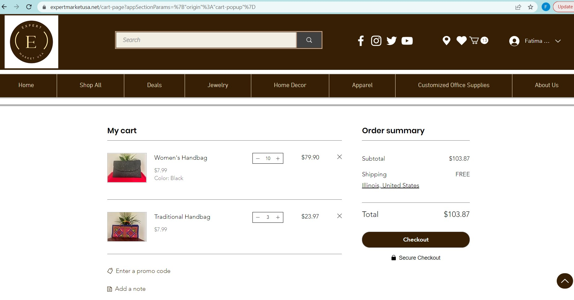

Slide 20
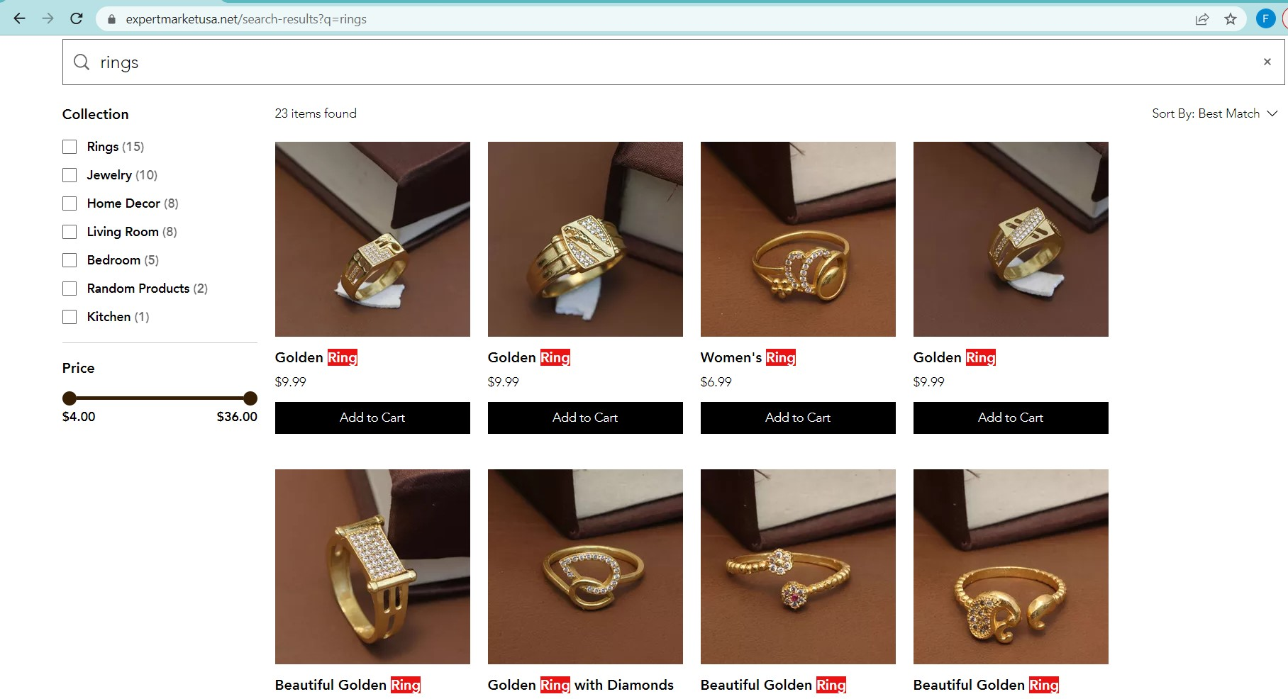

Slide 21
Test Schedule

Slide 22
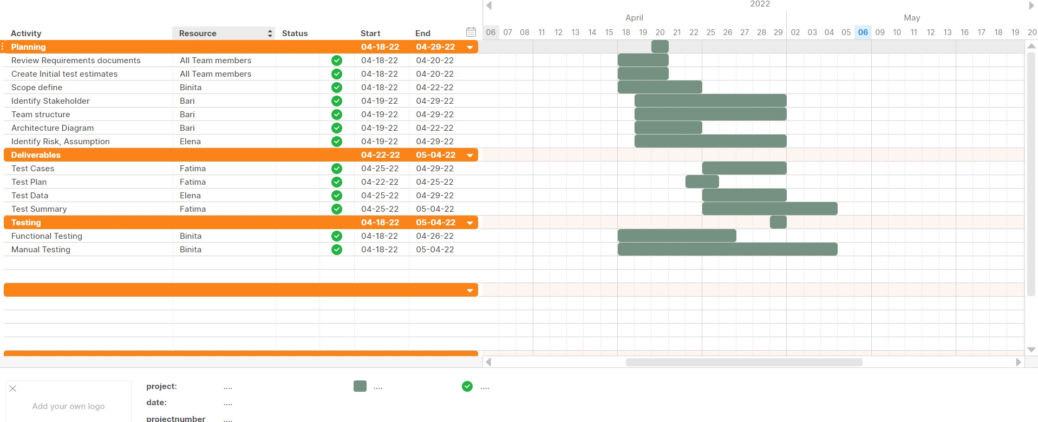

Slide 23
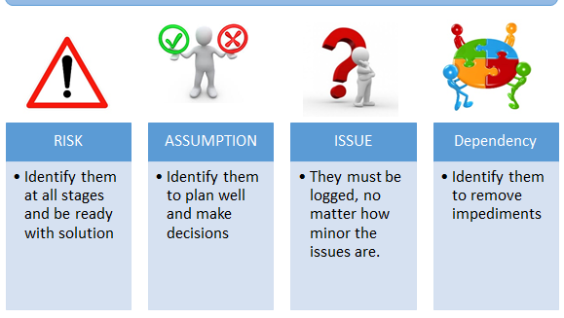

Slide 24
RAID
Risk:
If the website http://expertmarketusa.com goes down on the presentation day
If team members don’t show up on presentation day
Exhaustive testing cannot be done
Long testing could cost to customer over agreed rate
If a defect is found after release of project, customer can complain
Assumptions:
That everyone will perform their respective responsibilities and steps of a test plan
Everyone has access to the tools needed for the project
Issues:
Arranging available timings for meetings
Lack of time
Dependency:
Test schedule
Test Data
Test Cases
Architectural Diagram

Slide 25
Test Summary
4 Manual Test Cases were performed successfully by our team.
Adding an item to the cart test case was high priority and was hence executed first.
All the test cases passed and were signed off by our QA team and handed over to BA.
After our QA Manager and BA approved the tests, it was signed off by the PO – Product owner and the functionality went live under production.

Slide 26







MindMup

Slide 27

We created a whats app group and from there decided times which worked for us. We met on 4/18/22, 4/22/22 and 5/6/22 in the afternoons over Zoom. We shared our documents via gmail and whatsapp.

Slide 28
Key Challenges
One of the issues was some team members were not available during planning phase, while one wasn’t available for presentation day.
We divided the tasks equally between the members, but the presentation itself wasn’t assigned or divided between members early on, leading to only one member ending up working on it in the end.
Due to delay in planning phase and dependencies involved, we couldn’t plan our presentation ahead of time.
Backup plan needed to be discussed early on and the work needed to be divided and balanced according to backup plan and a deadline needed to be set for going over the project with all team members.

Slide 29


Fatima Tanveer Ftanveer.jobs@gmail.com Elena PonomaREVa egpond11@gmail.com Binita Patel binitarpatel@gmail.com Bari Vadaria bari.vadaria@gmail.com

